Slide 1
How has Denmark’s welfare state developed, and how does it relate to economic growth?

Slide 2
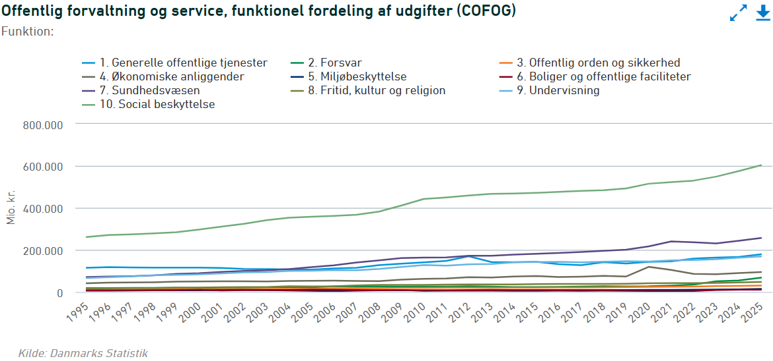
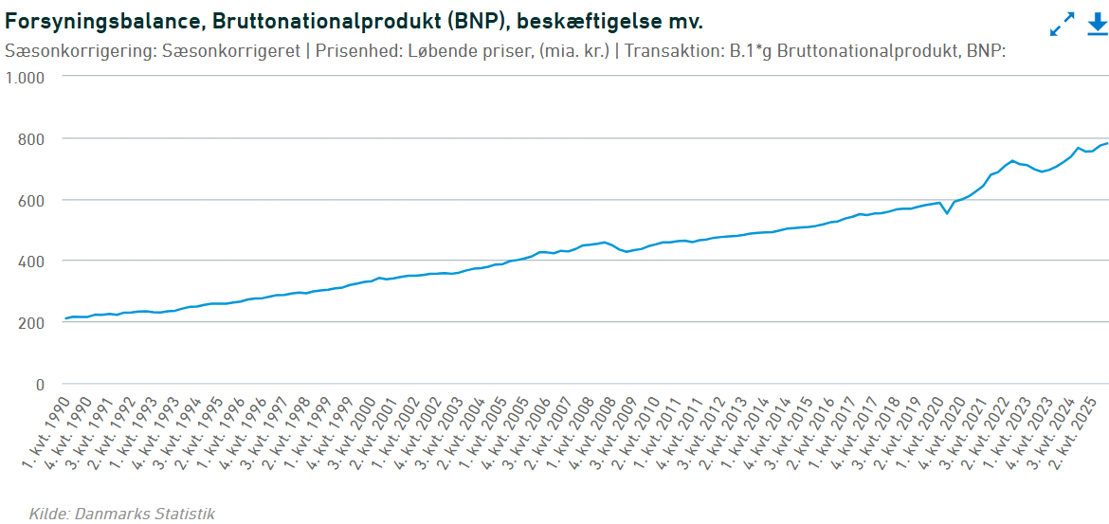

Slide 3
